Slide 1

Home
Login
Register
Bus Ticket Booking
FASTX

Slide 2
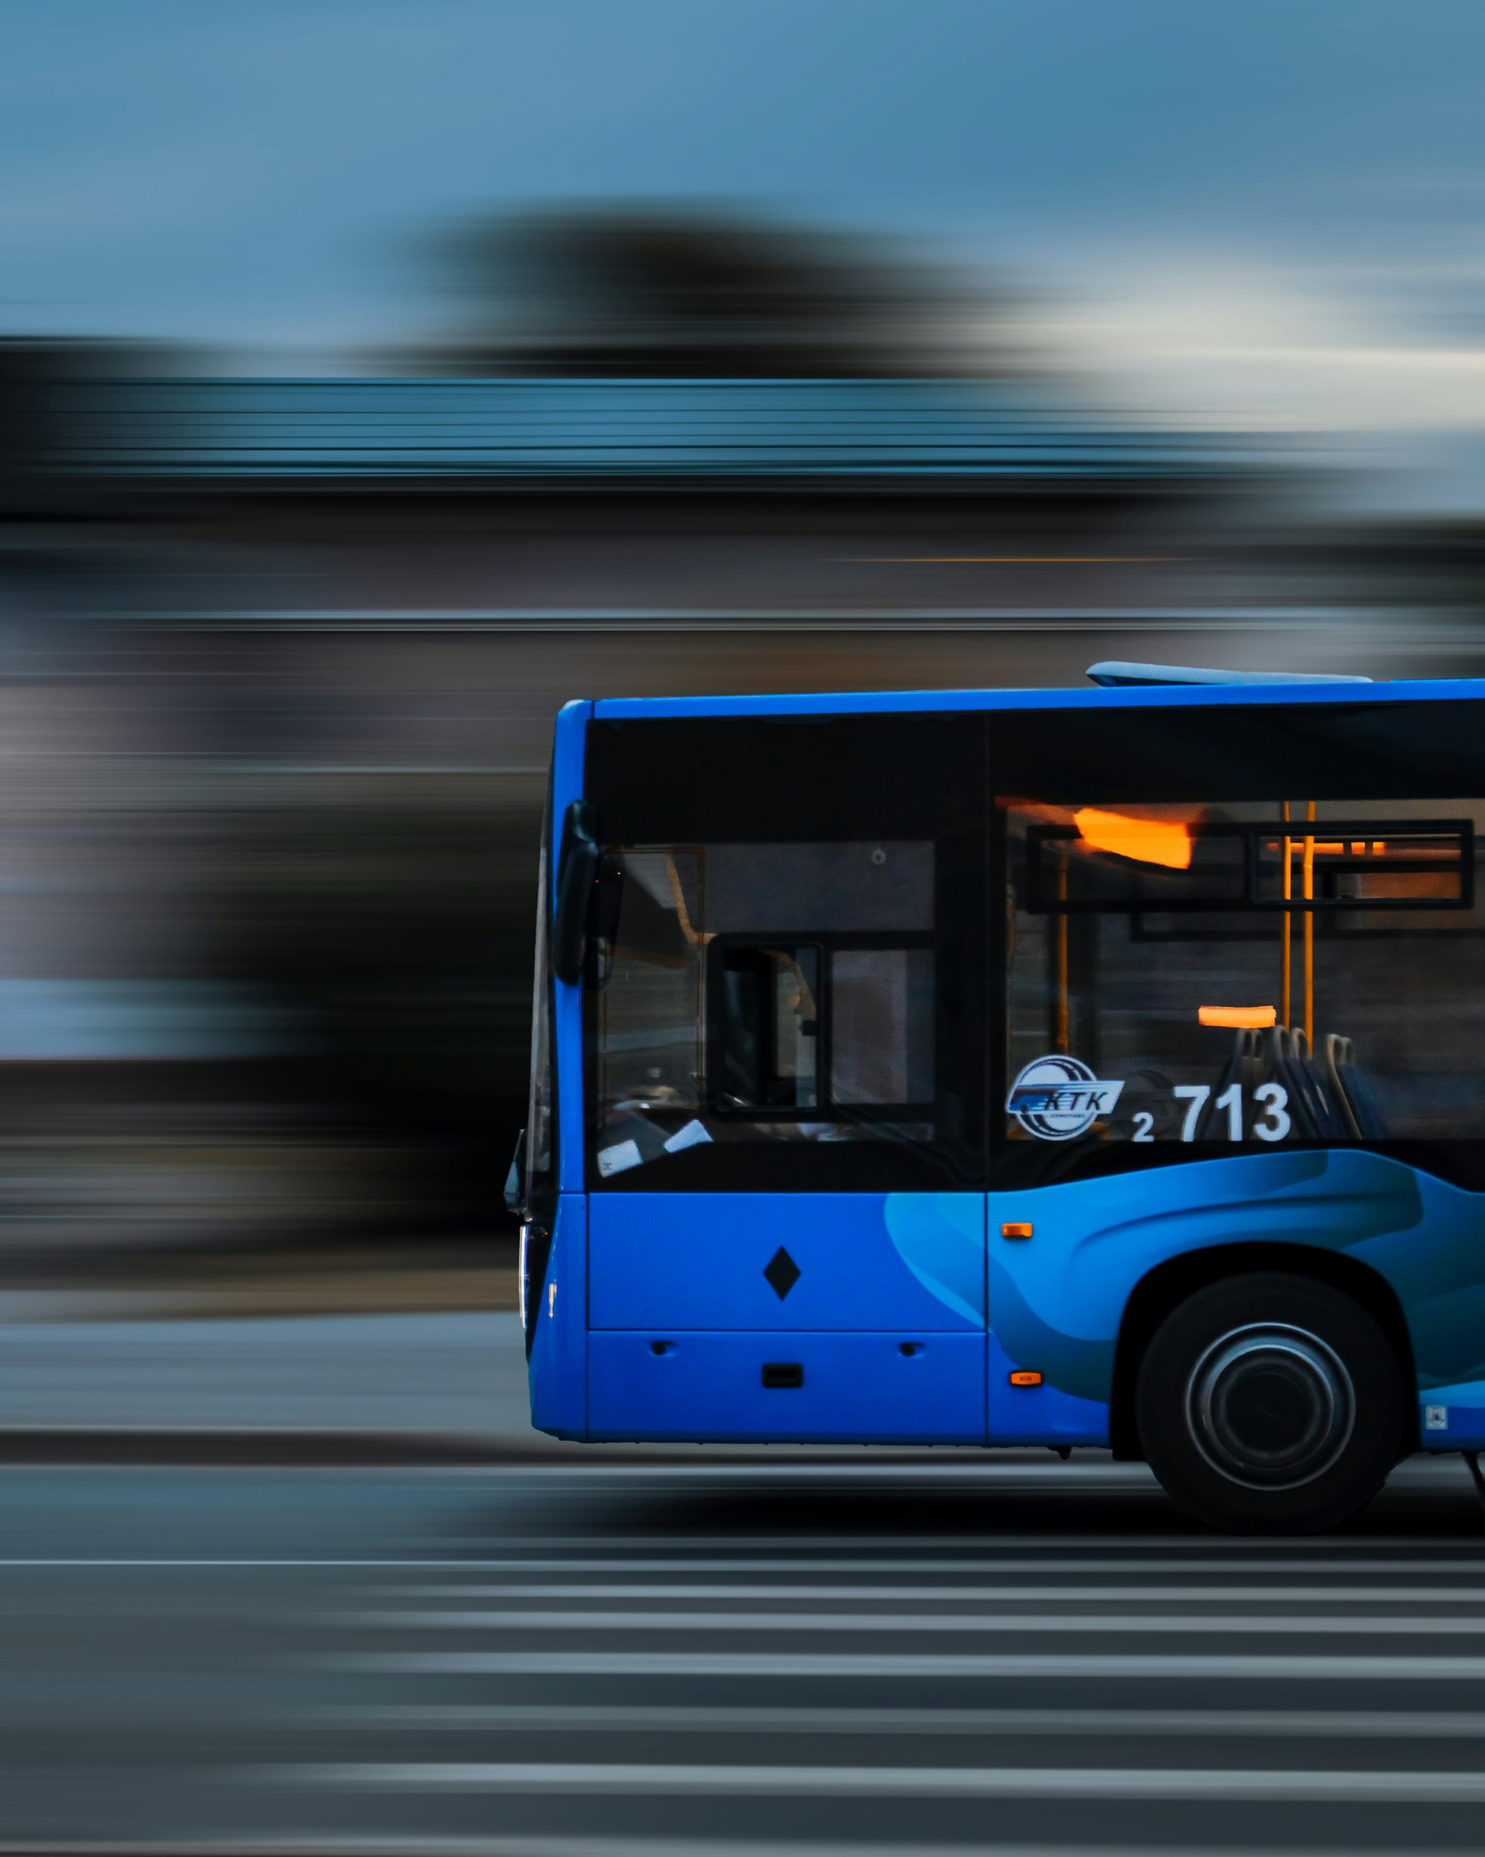
NAME: S.G.KAVIYA
TRAINER NAME: JAVEED MOHAMMED HUSNUDDIN

Slide 3
Search...
TECHNOLOGIES USED
Frontend: React.js
Backend: Java (Spring Boot)
Database: MySQL
Authentication: JSON Web Tokens (JWT)
Additional Tools:
Swagger and postman (API testing & documentation)
AWS / Azure (cloud deployment)

Slide 4

PROJECT DESCRIPTION
FastX – Online Bus Ticket Booking System is a web-based platform that allows users to search routes, check schedules, book seats, make payments, and manage bookings easily. Passengers can view history, cancel tickets, and update profiles, while operators and admins manage routes, fares, and bookings through dedicated dashboards. The system ensures security with JWT authentication and delivers a seamless experience using React.js, Spring Boot, and MySQL.

Slide 5
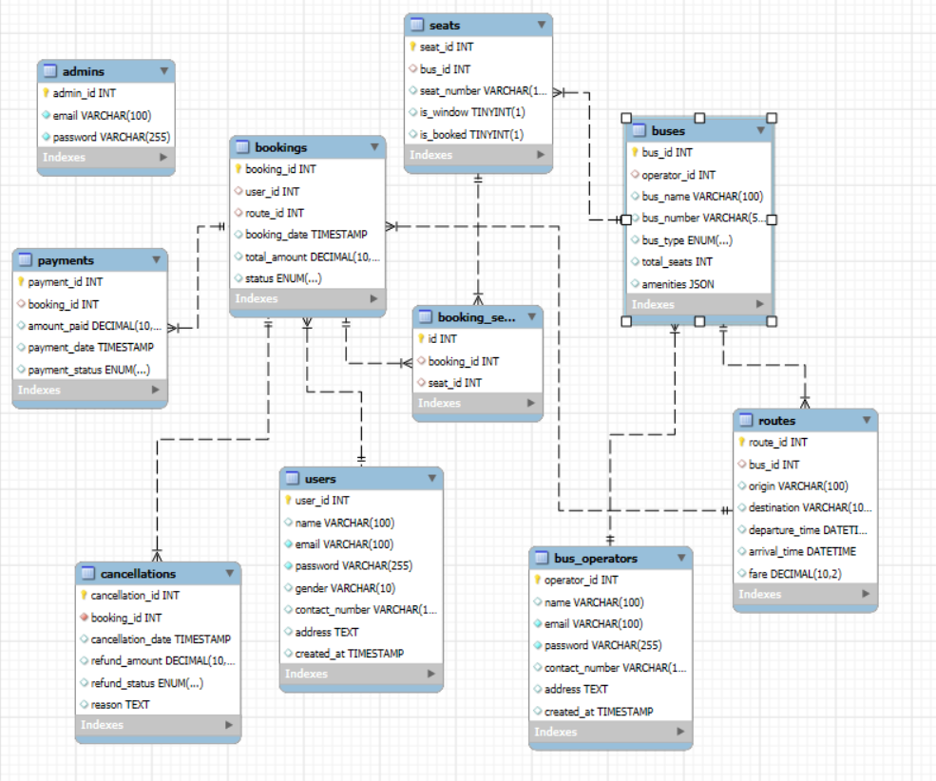
ER
DIAGRAM

Slide 6
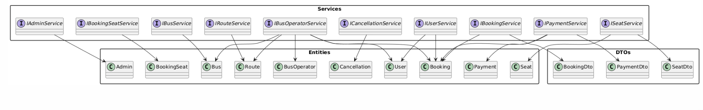
CLASS DIAGRAM

Slide 7
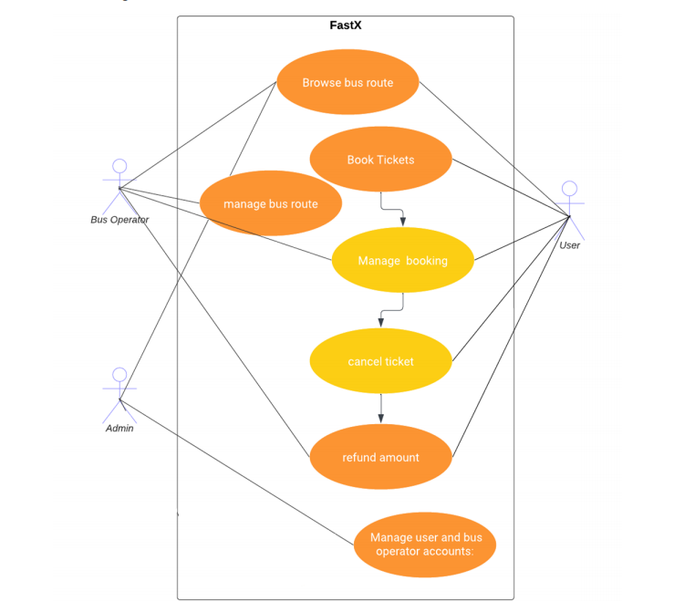
USE CASE
DIAGRAM

Slide 8
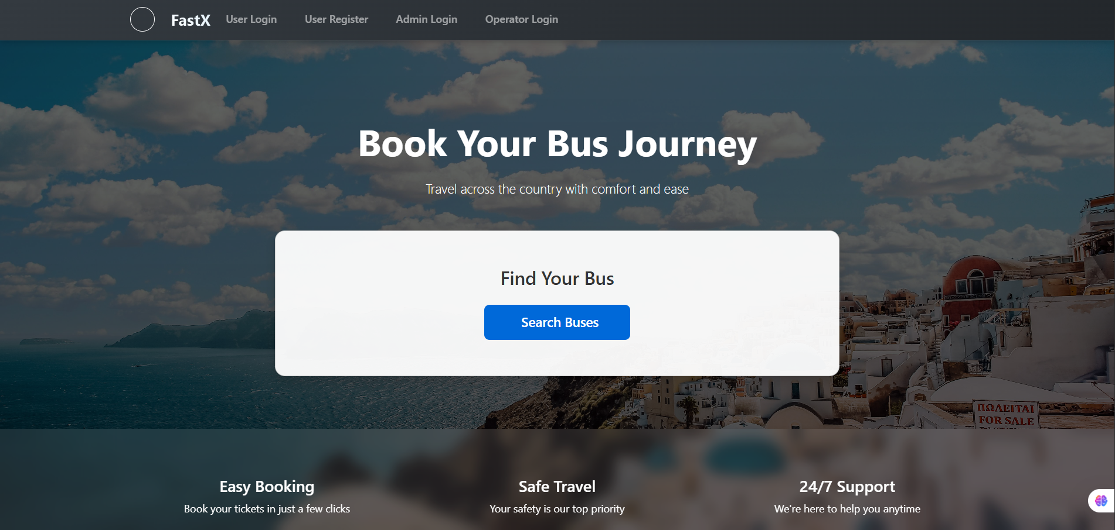
HOME PAGE

Slide 9
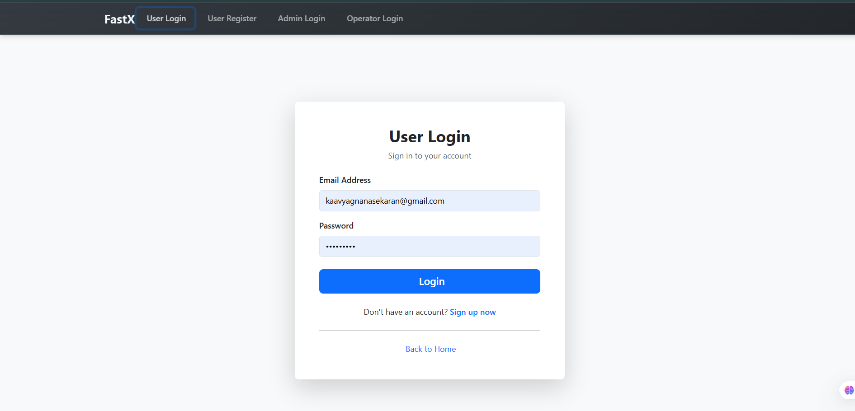
LOGIN

Slide 10
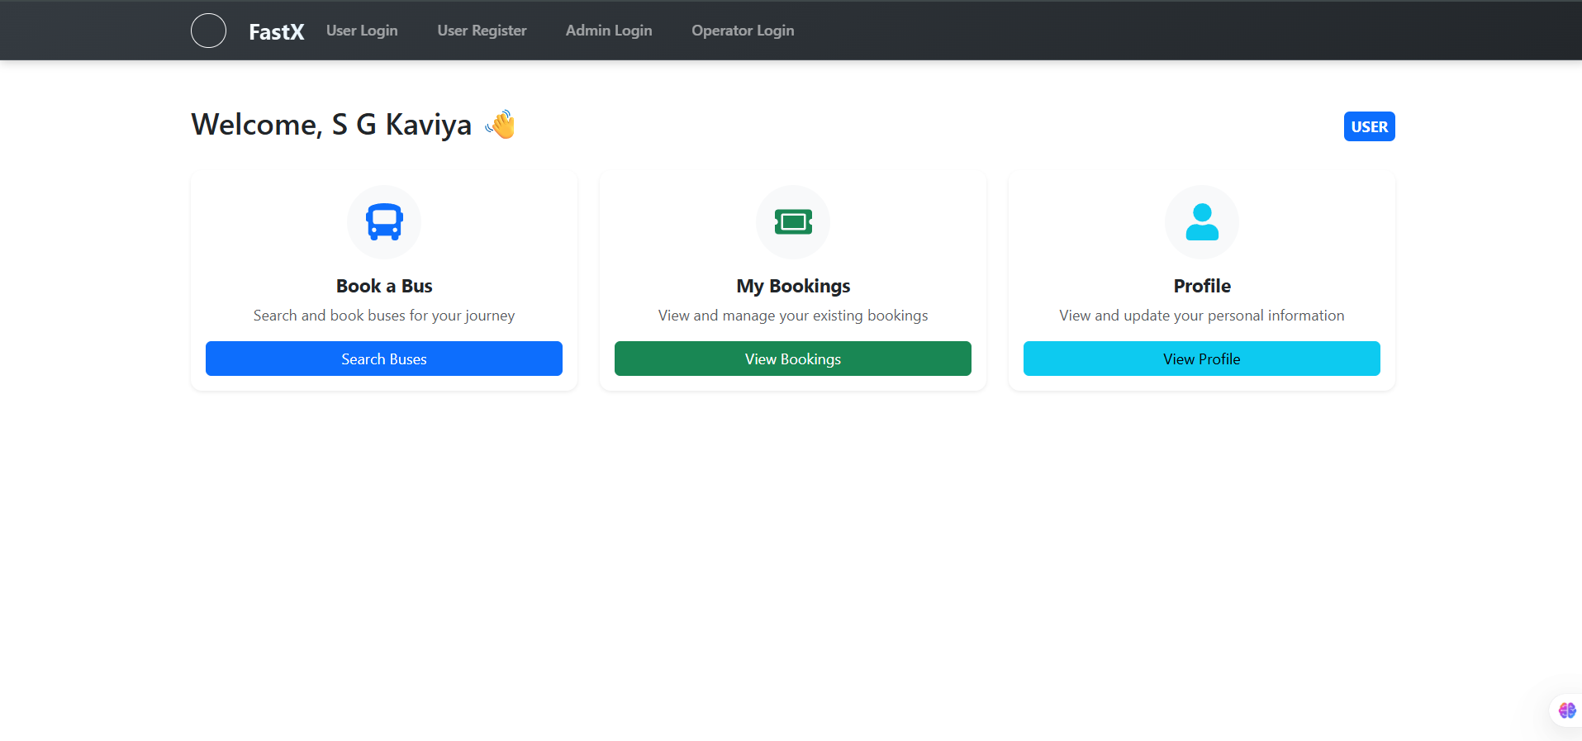
USER DASHBOARD

Slide 11
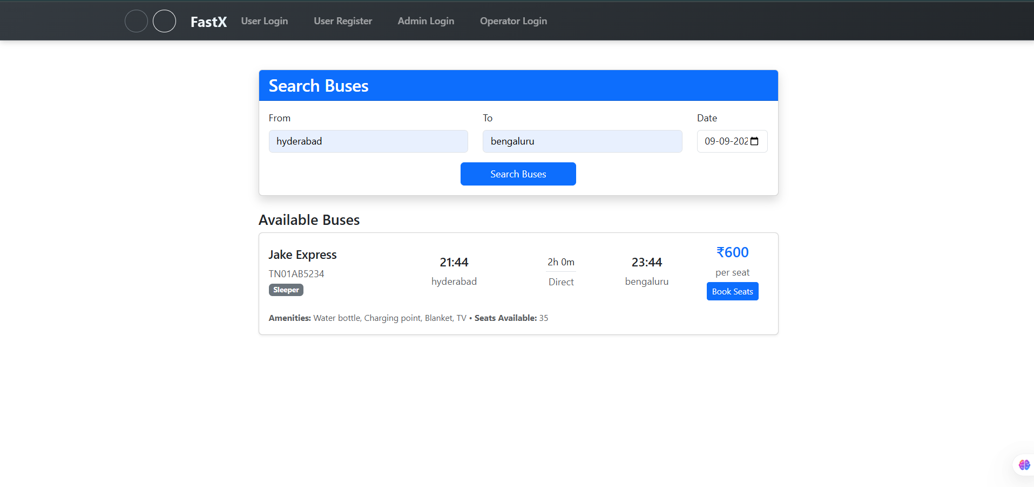
BOOK A BUS

Slide 12
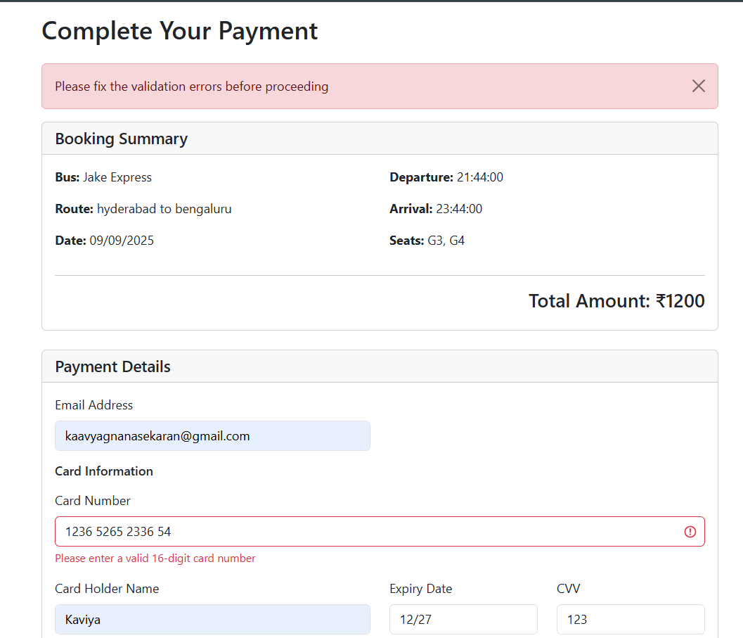
PAYMENT VALIDATION

Slide 13
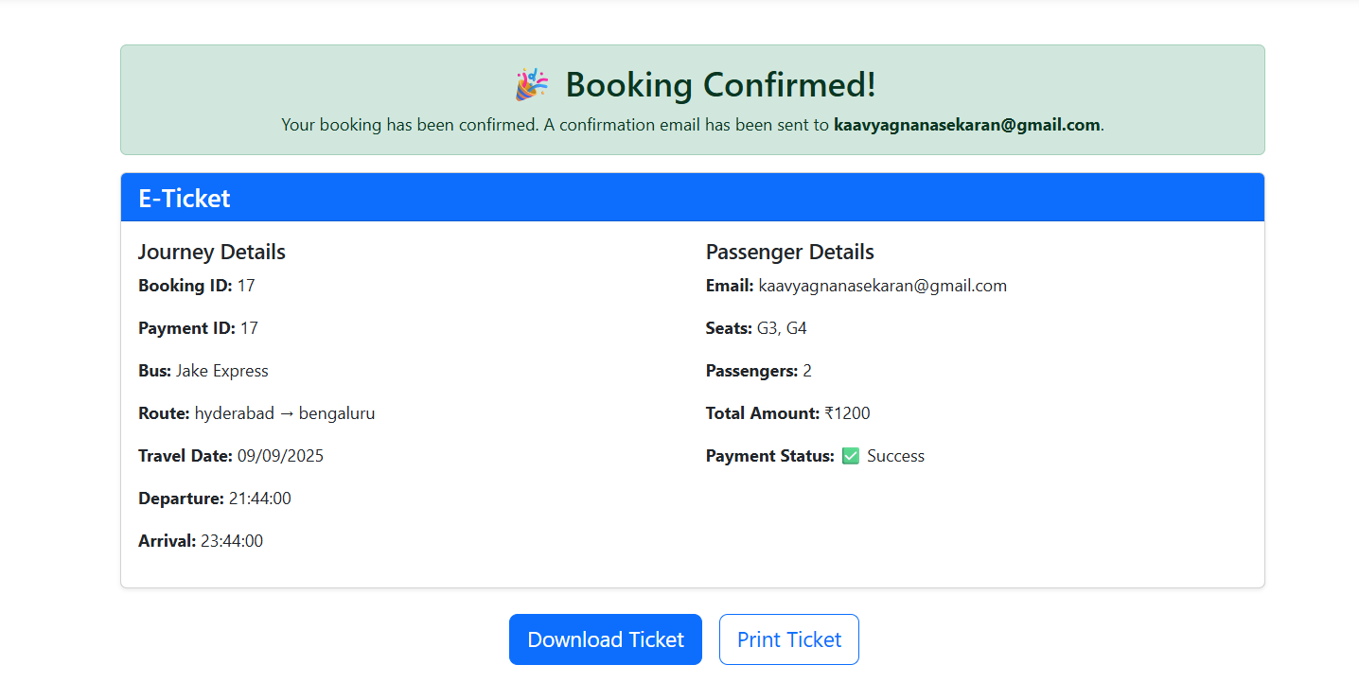
TICKET

